Slide 1
Cluster Evaluation

Slide 2
“When I try out a clustering method on a data set, how can I
evaluate whether the clustering results are good? ”

Slide 3
Introduction
In general, cluster evaluation assesses the feasibility of clustering analysis on a data set and the quality of the results generated by a clustering method.
Clustering evaluation include the following tasks:
Assessing clustering tendency.
Determining the number of clusters in a data set.
Measuring clustering quality.

Slide 4
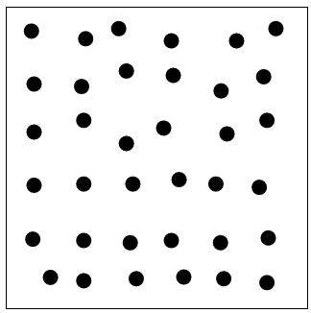
Assessing Clustering Tendency
Clustering tendency assessment determines whether a given data set has a non-random structure, which may lead to meaningful clusters.
Consider a data set that does not have any non-random structure, such as a set of uniformly distributed points in a data space.
Even though a clustering algorithm may return clusters for the data, those clusters are random and are not meaningful.

Slide 5

Assessing Clustering Tendency
Assess if non-random structure exists in the data by measuring the probability that the data is generated by a uniform data distribution
Test spatial randomness by statistic test: Hopkins Static
  Given a dataset D regarded as a sample of a random variable o, determine how far away o is from being uniformly distributed in the data space
  Sample n points, p1, …, pn, uniformly from D. For each pi, find its nearest neighbor in D: xi = min{dist (pi, v)} where v in D
  Sample n points, q1, …, qn, uniformly from D. For each qi, find its nearest neighbor in D – {qi}: yi = min{dist (qi, v)} where v in D and v ≠ qi
  Calculate the Hopkins Statistic:
H=∑ni=1yi∑ni=1xi+∑ni=1yiH=∑i=1nyi∑i=1nxi+∑i=1nyi
  If D is uniformly distributed, ∑ xi and ∑ yi will be close to each other and H is close to 0.5. If D is clustered, H is close to 1

Slide 6
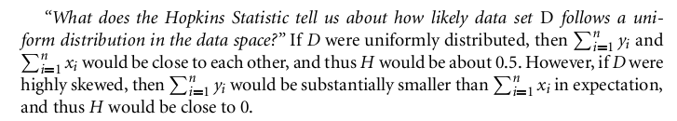
Assessing Clustering Tendency

Slide 7
Determining the Number of Clusters
Determining the “right” number of clusters in a data set is important, not only because some clustering algorithms like k-means require such a parameter, but also because the appropriate number of clusters controls the proper granularity of cluster analysis.
It can be regarded as finding a good balance between compressibility and accuracy in cluster analysis.

Slide 8
Determining the Number of Clusters
What if you were to treat the entire data set as a cluster? This would maximize the compression of the data, but such a cluster analysis has no value.
On the other hand, treating each object in a data set as a cluster gives the finest clustering resolution (i.e., most accurate due to the zero distance between an object and the corresponding cluster center).
In some methods like k-means, this even achieves the best cost. However, having one object per cluster does not enable any data summarization.

Slide 9
Determining the Number of Clusters
Figuring out what the right number of clusters should be often depends on the distribution’s shape and scale in the data set, as well as the clustering resolution required by the user.

Slide 10
Measuring Clustering Quality
“How good is the clustering generated by a method, and how can we compare the clustering's generated by different methods?”
We have a few methods to choose from for measuring the quality of a clustering.
In general, these methods can be categorized into two groups according to whether ground truth is available.
Here, ground truth is the ideal clustering that is often built using human experts.

Slide 11
Measuring Clustering Quality
If ground truth is available, it can be used by extrinsic methods, which compare the clustering against the group truth and measure.
If the ground truth is unavailable, we can use intrinsic methods, which evaluate the goodness of a clustering by considering how well the clusters are separated.
Ground truth can be considered as supervision in the form of “cluster labels.” Hence, extrinsic methods are also known as supervised methods, while intrinsic methods are unsupervised methods.

Slide 12
Measuring Clustering Quality
Two methods: extrinsic vs. intrinsic
Extrinsic: supervised, i.e., the ground truth is available
  Compare a clustering against the ground truth using certain clustering quality measure
  Ex. BCubed precision and recall metrics
Intrinsic: unsupervised, i.e., the ground truth is unavailable
  Evaluate the goodness of a clustering by considering how well the clusters are separated, and how compact the clusters are
  Ex. Silhouette coefficient

Slide 13
Clustering quality measure: Q(C, Cg), for a clustering C given the ground truth Cg.
Q is good if it satisfies the following 4 essential criteria
Cluster homogeneity: the purer, the better
Cluster completeness: should assign objects belong to the same category in the ground truth to the same cluster
Rag bag: putting a heterogeneous object into a pure cluster should be penalized more than putting
it into a rag bag (i.e., “miscellaneous” or “other” category)
Small cluster preservation: splitting a small category into pieces is more harmful than splitting a large category into pieces

